Slide 1
Repositioning task in Markov Decision Process

Slide 2






$$a_{5}$$
State:
$$s=\left\langle grid,time_stamp\right\rangle$$
Action:
$$a←Top−k transitions in the data$$
$$a=\left\{a_{1},a_{2},a_{3},a_{4},a_{5},a_{6}\right\}$$
Reward:
$$R= fee− α∗distance$$
$$a_{3}$$
$$a_{2}$$
$$a_{1}$$
$$a_{4}$$

Slide 3
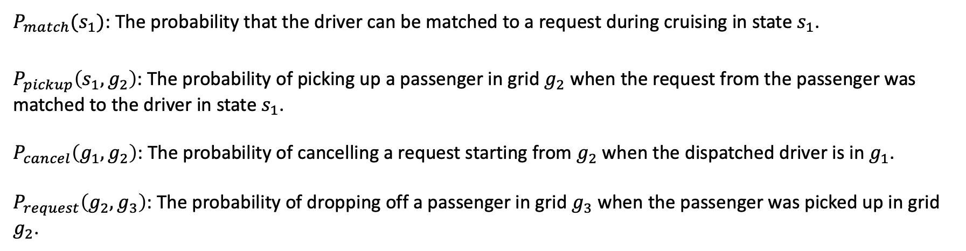
$P_{match}(s_{1})$: The probability that the driver can be matched to a request during cruising in state $s_{1}$.
$P_{pickup}\left(s_{1},g_{2}\right)$: The probability of picking up a passenger in grid $g_{2}$ when the request from the passenger was matched to the driver in state $s_{1}$.
$P_{cancel}\left(g_{1},g_{2}\right)$: The probability of cancelling a request starting from $g_{2}$when the dispatched driver is in $g_{1}$.
$P_{request}\left(g_{2},g_{3}\right)$: The probability of dropping off a passenger in grid $g_{3}$ when the passenger was picked up in grid $g_{2}$.

Slide 4

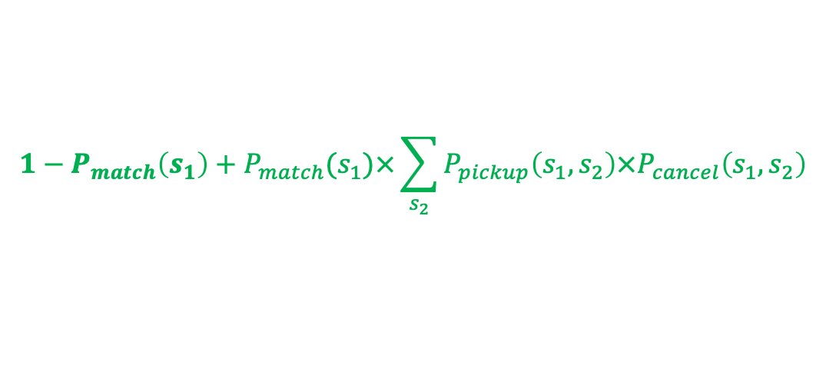




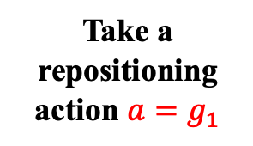
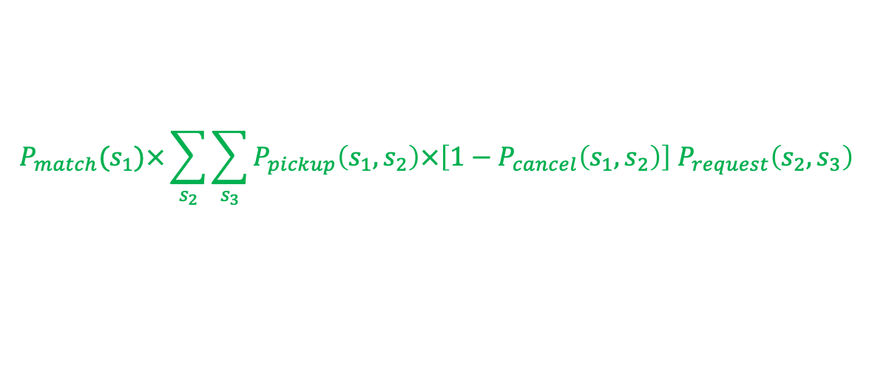
$${1−P}_{match}\left(s_{1}\right)+P_{match}(s_{1})×\sum_{s_{2}}{P_{pickup}\left(s_{1},s_{2}\right)×P_{cancel}\left(s_{1},s_{2}\right)}$$
$$Prob=\frac{1}{7}$$
$$s_{1}=\left\langle g_{1},t_{1}\right\rangle$$
Take a repositioning action ${a=g}_{1}$
$$Reward=−β×travel_time$$
$$s_{0}=\left\langle g_{0},t_{0}\right\rangle$$
$$s_{3}=\left\langle g_{3},t_{3}\right\rangle$$
$$P_{match}(s_{1})×\sum_{s_{2}}{\sum_{s_{3}}{P_{pickup}\left(s_{1},s_{2}\right)×\left[1−P_{cancel}\left(s_{1},s_{2}\right)\right] P_{request}\left(s_{2},s_{3}\right)}}$$
$$Reward=fee\left(s_{2},s_{3}\right)−β×travel_time$$

Slide 5
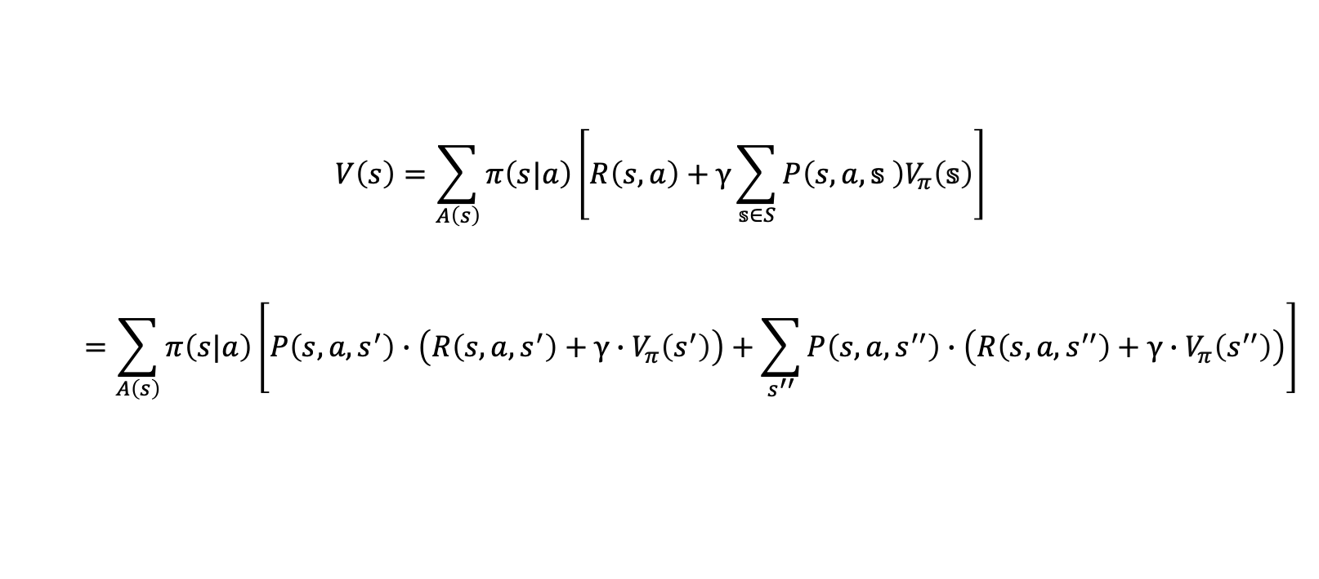
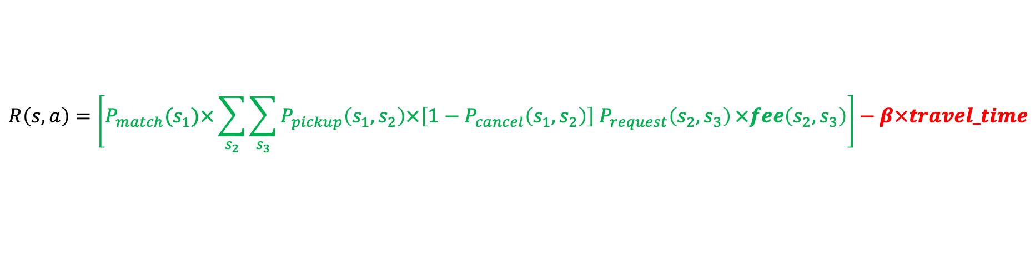
$$R\left(s,a\right)=\left[P_{match}(s_{1})×\sum_{s_{2}}{\sum_{s_{3}}{P_{pickup}\left(s_{1},s_{2}\right)×\left[1−P_{cancel}\left(s_{1},s_{2}\right)\right] P_{request}\left(s_{2},s_{3}\right)}×fee\left(s_{2},s_{3}\right)}\right]−β×travel_time$$
$$V\left(s\right)=\sum_{A\left(s\right)}{π\left(s|a\right)\left[R\left(s,a\right)+γ\sum_{𝕤∈S}{P\left(s,a,𝕤 \right)V_{π}\left(𝕤\right)}\right]}$$
$$=\sum_{A\left(s\right)}{π\left(s|a\right)}\left[P\left(s,a,s^{′}\right)∙\left(R\left(s,a,s^{′}\right)+γ∙V_{π}\left(s^{′}\right)\right)+\sum_{s^{′′}}{P\left(s,a,s^{′′}\right)∙\left(R\left(s,a,s^{′′}\right)+γ∙V_{π}\left(s^{′′}\right)\right)}\right]$$

